Slide 1


Welcome to CNAS Highlander Advising Support & Registration
Summer 2026
CNAS SCHOLARS
Class of 2030

Slide 2
BEFORE WE BEGIN…
Be Proactive:
Be Attentive:
Stay Calm
*We are here to help
*After today, follow up with your assigned advisor on other questions
*Have a Pen or Pencil
*Take Notes
*Write Down Questions
PLEASE HOLD OFF ON QUESTIONS
*Silence Phones
*Limit Distractions
*Read Instructions Carefully
FERPA Policy:
*If you receive one-on-one consultation today, please note permission will be needed if someone is your in Zoom meeting with you

Slide 3
PLEASE HAVE THE FOLLOWING READILY
AVAILABLE JUST IN CASE:
AP/IB Score Report*
Unofficial College Transcripts*
Highlander Foundations Canvas Course https://canvas.ucr.edu/
R’Web log-in info (to view placements, register, & student academic summary)
*If Applicable
*If Applicable

Slide 4




TODAY’S AGENDA
ABOUT US
WHAT WE DO
PLACEMENT
REGISTRATION
Get to know your CNAS academic advisors.
General academic advising information.
MATH and WRITING/ENGLISH.
Help you finalize your Fall 2026 schedule with sample schedules!

Slide 5
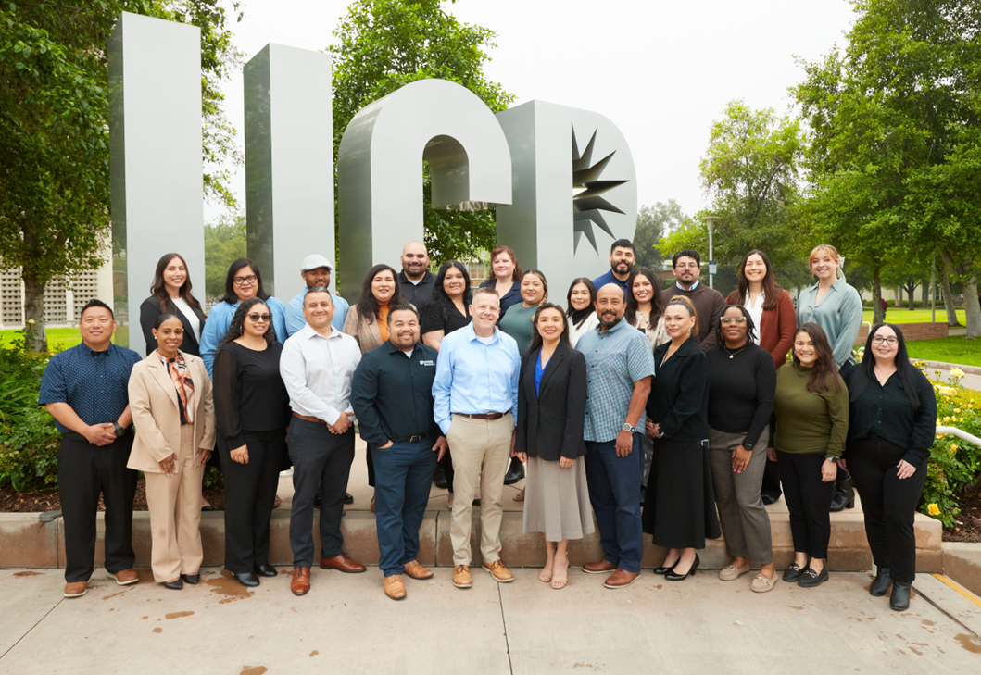
MEET THE TEAM

Slide 6

THE ROLE OF ADVISOR
Academic Advisor – Guidance, support, and resourceful
Assist
Monitor
Refer

Slide 7
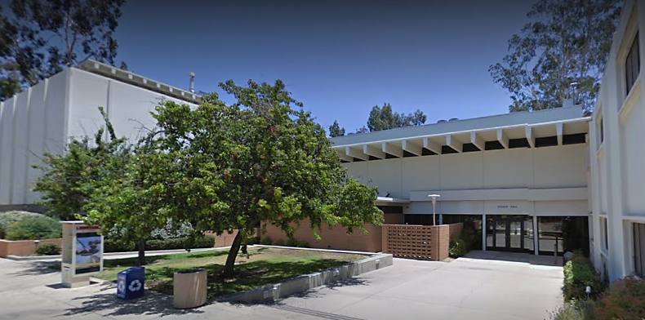



ACADEMIC
ADVISING IN CNAS
Advising Sessions:
In-Person & Via Zoom
GUAC (General Undergraduate Advising
Check-In's):
M – F
*Check Quarterly
Schedule
For Specific Hours
E-mail or Call
M-F (8am to 4pm)
Wed: we open at 10am
-Visit cnasstudent.ucr.edu for appropriate advisor’s contact information
-Use cnasstudent.ucr.edu to schedule an appointment with your assigned advisor (becomes accessible once fall quarter begins)
-For general advising questions e-mail:
cnaspeeradvisors@ucr.edu or cnasstudent@ucr.edu

Slide 8
MATH & ENGLISH
PLACEMENTS

Slide 9
AP Exams: English and MATH
Depending on AP and/or IB scores, appropriate Writing and math course credit will be given.
Please refer to your AP/IB scores.

Slide 10

MATH 003– College Math Fundamentals & Problem Solving
3 UNITS
Grading: S/NC
(80% is a passing grade)
Prerequisite: Math Placement Assessment (MPA)
Prepares for success in a college-level mathematics course
Available during Summer, Fall, and Winter
Must be taken until successful completion
Math 003 units apply toward your financial aid eligibility & full-time status. They will not count towards the 180 total units to needed to graduate
With Math 003 fall enrollment, you will be able to participate in the Early Assist Program - dedicated academic support program
  More information at https://arc.ucr.edu/early-assist

Slide 11
MATH PROGRESSION
MATH003
College Math Fundamentals
Pre-Cal
Beyond Calculus
Calculus
The life-science majors are calculus-based and requires completion through second quarter Calculus.
Math and physical majors will require beyond single variable Calculus.
Your MPA score or your AP credit will determine your appropriate placement. Your AP Calculus score will override the MPA placement score if higher.
MATH placement scores may place students in MATH 006A and MATH 06LA and final grades, will determine next MATH requirements.
If you do not have AP credit and haven’t taken the MPA, then do so ASAP.
  Visit the Academic Resource Center’s Website (arc.ucr.edu) for test information and deadlines.

Slide 12
MATH PROGRESSION FIRST YEAR: LIFE SCIENCES
Fall
Winter
Spring
Fall
MATH003
MATH006A (6LA)
MATH006B (6LB)
MATH007A
MATH007A
MATH007B
MATH005A
MATH007A
MATH007A
MATH007B
Consult w/advisor for additional math

Slide 13
MATH PROGRESSION FIRST YEAR: Math & Physical Sciences
Fall
Winter
Spring
Fall
MATH003
MATH006A
MATH006B (6LB)
MATH009A
MATH005A
MATH005B
MATH005C
MATH009A
MATH009B
MATH009C

Slide 14
WRITING PROGRESSION
Entry-Level Writing Requirements Series
First-Year Writing & Composition
(breadth)
Be aware that some writing courses have corresponding labs. You must search & register for these labs separately and they must be included in your registration.
Your Writing Placement Process (WPP) score or your AP credit will determine your appropriate placement. Your AP score will override your WPP score placement if higher.
If you do not have AP credit and haven’t taken the Writing Placement Process exam, then do so ASAP.
  Visit the University Writing Program Website (uwp.ucr.edu/elwr) for test information and deadlines.

Slide 15
WRITING PROGRESSION FIRST YEAR
Fall
Winter
Spring
Fall
Winter
WRIT001/01L
WRIT003/03L
WRIT005/05L
WRIT007/07L
WRIT010
1st-year writing
WRIT009/09L
WRIT020
1st-year writing
WRIT030
1st-year writing

Slide 16
WRITING: Priority Enrollment
Placement
Priority Term
WRIT001
WRIT001
Fall 2026
Fall 2026
WRIT003
WRIT003
Fall 2026
Fall 2026
WRIT009
WRIT009
Fall 2026
WRIT005 & WRIT007
Winter 2027
WRIT010, 020, 030
Any term in first year

Slide 17
MAKING FORWARD PROGRESS IN ALL COURSES
OVERALL PROGRESSION
We know you all will be successful students.
Something to know going forward: all courses may be retaken only once.
Hence, it’s important to balance your overall schedule and first-year experience
Full-time enrollment status is considered 12 or more units.
Typical unit workload per quarter is 16 units and may vary depending on summer enrollment.
If you have at least 14 to 17 units, your fall schedule is considered complete.
  Remember, we are here for you: https://cnasstudent.ucr.edu/

Slide 18

CHANGE OF MAJORS
Currently
Change of majors are not reviewed at this time.
Future Eligibility
Change of majors can be pursued in the first academic year.
* Note: Must meet specific change of major criteria.
Academic Planning

Slide 19

FALL 2026
LET’S FINALIZE FALL REGISTRATION

Slide 20
UCR BREADTH COURSES
Degree Requirements
CNAS BREADTH courses are part of your degree requirements. Please be sure to review breadth information in Highlander Foundations Canvas course.
CNAS
Registration Resources
An open course list will be provided as you are registering for courses today.
CNAS ADVISING
SUPPORT & SUCCESS
Notes:
CNAS Breadth sheet (updated): cnas-breadth-sheet.pdf (ucr.edu)
Sheet lists breadth requirements for CNAS, as well as the typical courses students take to fulfill each category.
Courses listed are numbered 1-99, which means they are lower division
The specific number associated with a course helps to identify the topic, rather than the difficulty level. For example, ECON 005 isn’t necessarily more difficult than ECON 001, it’s just covers a different topic within that field.

Slide 21
MATH COURSE CLARIFICATION
MATH 005A
One-term pre-calculus course
Higher placement level
NOTE
MATH 006A
Two-term pre-calculus course
CNAS ADVISING
MATH PLACEMENT GUIDE

Slide 22
MATH 006A PLACEMENT
Note: There are two types of MATH006A placement.
1. MATH006A alone placement
2. MATH006A & 06LA placement
Students will have to look up “MATH06LA” in the schedule of classes if you need to add MATH006A with 06LA.
CNAS ADVISING
REGISTRATION GUIDE

Slide 23
CNAS LEARNING COMMUNITY (LC)
PLEASE REMEMBER
Math/Sci Core Classes Only: LC includes only core math/science; you must enroll in breadth courses on your own.
No Changes: The LC schedule is fixed and cannot be modified.
Linked Components: Some courses include mandatory linked Discussions and/or Labs.
Freshman Seminar: Required component of the program.
Supplemental Instruction: Mandatory attendance is required.
CNAS ADVISING
FALL 2026 SCHEDULE GUIDE
*Placement scores may require MATH 006A and MATH 06LA.

Slide 24
YOUR FALL 2026 Sample Schedule
MATH 003 Placement –
Learning Community
Taking MATH 003
this Summer 2026?
You should have an LC with
MATH 6A for Fall 2026
MATH 003 (3)
WRITING (4-5)
BREADTH (4)
NASC 091 (1)
BREADTH (4)
Total Units: 14-17

Slide 25
YOUR FALL 2026 SAMPLE SCHEDULE
CNAS Learning Community (LC) – MATH006A
Course | # of Units
MATH 006A (Lecture) | 4
MATH 006A (Discussion) | 0
CHEM 001 | 2
NASC 091/094 (FR Seminar) | 1
ARC 073 | 0
Total | 7
*MATH placement scores may place students in MATH 006A and MATH 06LA.

Slide 26
YOUR FALL 2026 SCHEDULE
CNAS Learning Community – General Info
CHEM 001 is a prep course – it is not the same as CHEM1A/1LA.
If your LC schedule has 11 or less units, then you will add the appropriate WRIT and/or breadth courses to reach at least 12-17 units total.
Course | # of Units
MATH 006A (Lecture) | 4
MATH 006A (Discussion) | 0
CHEM 001 | 2
NASC 091 (Seminar) | 1
ARC 073 | 0
Total | 7
*MATH placement scores may place students in MATH 006A and MATH 06LA.

Slide 27
FALL 2026 LC EXAMPLE SCHEDULE
MATH 6B*
Course | # of Units
CHEM 001 | 2
NASC 091 (Seminar) | 1
ARC 073 | 0
Total | 4
*If MATH006A is taken in the summer, MATH will not be included in your LC block. You must enroll in MATH 6B on your own in the fall.

Slide 28


FALL 2026
MATH/PHYSICAL SCIENCES (MPS)
LC EXAMPLE SCHEDULE
MATH005A PLACEMENT
MATH 5A (4)
CHEM 01 (2)
NASC 091 (1)
WRIT (4-5)
BREADTH (4)
Total Units: 15-16

Slide 29
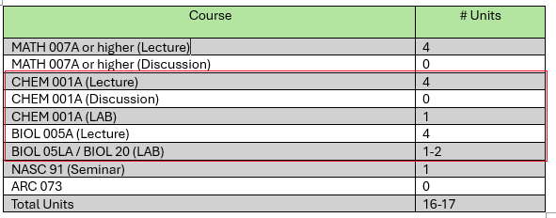
FALL 2026 LC EXAMPLE SCHEDULE
MATH 7A/9A or Higher​
Students who place in MATH 7A/9A or higher may have CHEM1A/1LA in their fall schedule​.
Life Science majors may have both CHEM1A/1LA and BIOL5A/5LA (or BIOL20)​.
Math and physical science majors will not have BIOL5A/5LA in their block.

Slide 30
STUDENTS WITHOUT A LC BLOCK
Why you don't have a block:
No math placement & Highlander Foundations incomplete
Student ATHLETES do not receive assigned LC blocks
Immediate Next Steps:
Await specific directions from your advisor
Prepare to enroll in courses independently
Enrollment Guidelines
Start by enrolling in 3 breadth courses (12 units)
Target a final schedule of 14-17 units as soon as math placement is obtained

Slide 31
YOUR FALL 2026 SCHEDULE
No Math Placement – No Learning Community*
WRITING (4-6)
BREADTH (4)
BREADTH (4)
Total Units: 12 minimum
*Once you have your math placement, email cnasscholars@ucr.edu for possible placement in a CNAS Learning Community
Must obtain 12-units minimum, with 16 units as final enrollment target
*Athletes will not have an assigned LC block.

Slide 32
NASC091 – Freshman Advising Seminar in CNAS
NASC094-Adventures in Science Biology
What is NASC 91 & 94?
Not required for your major but recommended to enroll for fall (must enroll if part of your LC block)
Some majors will have a specific seminar course that is part of the major 1-Unit
NASC 91 is offered in Fall; NASC 94 offered Fall, Winter, and Spring
NASC Seminars
an exploratory course that covers various topics related to the major. Students can get introduced in the subject and learn something new in their field. This also a great way to connect with staff and faculty, who are committed to your success in your major.
**Biochemistry majors will take BCH 095 in the fall, rather than NASC 91 or 94**

Slide 33
SUBMIT YOUR LC BLOCK
If students do not click the “submit” button to enroll in the assigned LC block and you choose NOT to participate in the LC program
    Student must enroll in ALL courses on their own
    There is no guarantee there will be available seats
    By not enrolling in the LC block, there is risk you may not be able to enroll in the courses you need for your major or breadth

Slide 34
Fall Enrollment Units
Please complete full-time enrollment (12 or more units) well before September 15, 2026 to avoid late enrollment fees.
Enroll in any remaining courses in addition to your LC block
Orientation fall registration closes August 21st at 11:59 PM
(unit cap is set at 17 units)
Second-pass registration opens on September 8, 2026 at 9am (unit cap increases to 20 units)

Slide 35
NEXT - REGISTRATION STEPS...
Focus on the present
Initiate and complete fall registration
Enroll in 14 to 17 units (16 is typical)
Primary goal is Fall registration-to earn units & a GPA
Peer Mentors, and Staff will be available to help

Slide 36
Reminder
Please check if your math placement is correctly listed in your LC block. An advisor will assist you.
Click the "submit" button to accept the LC block and for enrolling in all other courses
Advisors will assist you in the breakout room for any other issues

Slide 37



Registration window opens at 10:30 AM!
Wait for your advisor’s instructions in your assigned breakout room
Access your Registration
Begin your fall enrollment
Follow up with your advisor via e-mail, if you have you have questions regarding your Fall 2026 schedule.
*Orientation fall registration closes August 21st at 11:59pm.

Slide 38

NO MATH OR WRITING PLACEMENT
Obtain math placement as soon as possible
Breadth course enrollment
  Enroll in up to 14 to 17 units total.
Orientation fall registration closes August 21st @11:59pm
Second-pass registration opens on September 8th, 2026 at 9:00AM.

